Slide 1
Getting Started
CS771: Introduction to Machine Learning
Purushottam Kar

Slide 2
Announcements
Course has reached capacity – no more adds unless drops take place
Please sign-up on Piazza – we will discontinue use of emails soon
All discussions/queries only on Piazza – none over email
Class polls on whether to hold extra discussions also only over Piazza
Do not worry about Gradescope – I will signup all registered students
Reference list updated – more organized, math for ML resources

Slide 3
An overview of ML
Study similarity of ML with a student preparing for an exam
Look at a toy ML problem
Learn what is training data, test data?
Learn what is a model?
Warning: lots of oversimplifications ahead!

Slide 4



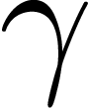

A typical study cycle (e.g. in a course)
TEST
TEST
TEST
Preparation
Practice Tests/Study Material
Actual Exam
EXAM
Subject Knowledge
Pass / Fail

Slide 5







Spam Filtering
Suppose Mary has already tagged several old emails as spam/non-spam, can we tag her new emails too?
Trick: use the old tagged emails to try and understand what sort of emails does Mary think of as spam and which as non-spam!
E.g. may find that emails about shopping always tagged as spam
E.g. may find that emails from Jill are never tagged as spam
These insights/patterns are what are stored in the spam filter
Our spam filter helps us make predictions on new emails

Slide 6





A typical ML workflow
ML Algorithm
Ah! That is the fun (and artistic) bit about ML. We will learn tons of ways on how ML algos store patterns
Old Emails
The spam filter stores information about your personal preferences about what looks spam to you
New Emails
How is this information stored?
Spam Filter
Spam/Non-spam

Slide 7
A typical ML workflow
ML Algorithm
Training Data
Test Data
Model
Output

Slide 8

ML as an “examination”
Our brain stores subject matter
Use subject matter to solve exam
Critical to do well on exam-day
Mock test results indicative
No out-of syllabus questions
Should not leak exam paper before exam
The model stores data patterns
Use model to predict on test data
Critical to do well on test data
Training accuracies indicative
Training/test data are similar
Should not look at test data while training

Slide 9
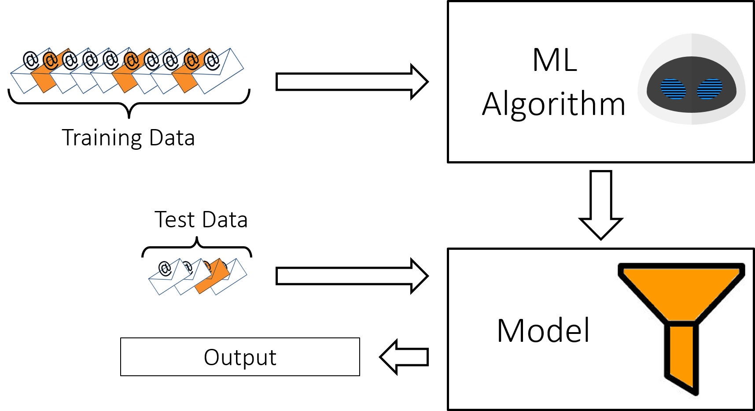
A typical ML workflow

Slide 10








ML can do lots of cool things with test data
In this course, we will learn how to do most of these operations with test data
Test Data
Regression
Multi-classification
Clustering
URGENT, OFFICIAL, TAX
Tagging
Binary Classification
Ranking
$$>$$
$$>$$
$$>$$

Slide 11
A typical ML workflow

Slide 12
ML can take in lots of kinds of training data
We wont be able to cover all these training settings in this course – there are entire courses devoted to specific training settings e.g. CS773 (Online Learning)
Training Data
Batch Learning
Active Learning
Robust Learning
Supervised Learning
Semi-supervised Learning
Online Learning
Unsupervised Learning
Reinforcement Learning

Slide 13
A typical ML workflow

Slide 14

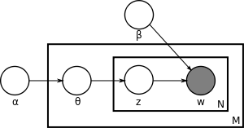

ML can store info in lots of innovative ways
ML Models and Algorithms
Linear/Opt
Local
Neural/Deep
We can mix-n-match these methods too e.g. Bayesian Deep Learning or Kernel Nearest Neighbours (Local)
We will learn how to use each of these techniques in the course, but a bit briefly. As before, there are entire courses devoted to each technique e.g. CS772 (Prob ML), CS774 (Opt)
Probabilistic/Bayesian
Kernel
Correct! But we will not be able to cover such advanced methods either

Slide 15
Fantastic Features
… and how to find them
What are vectors
How are vectors used in ML
Useful operations on vectors

Slide 16


What are features
Why did we not keep the word “to” as a feature?
We could have – but it does not carry much information about spam/non-spam since it is such a common word!
Features are a way for us to give input to ML algorithms
Most ML algorithms use numerical vectors to represent features
For example, in spam classification, every old email (training data) as well as every new email (test data) must be converted into a vector
Guys, something is wrong with our feature. The word “do” means different things in two emails
Do | You | Want | Go | Million | Dollars | Dinner | Today
1 | 1 | 1 | 1 | 0 | 0 | 1 | 0
1 | 1 | 1 | 0 | 1 | 1 | 0 | 0
1 | 0 | 0 | 0 | 1 | 0 | 0 | 1
Do you want to go for dinner?
Do you want to win a million dollars?
I have a million things to do today!
Since I am basically a computer program, I need you to convert your data into a nice set of numbers
Good catch – this may not be the best feature representation!

Slide 17
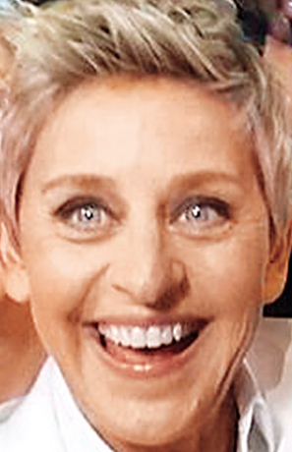

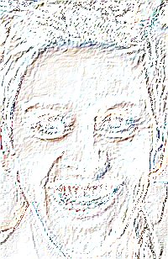

What are features
May represent images as a vector/matrix of pixel RGB values
May instead encode images using edges present in them
May instead encode images using presence of eyes/noses/ears
Makes sense. Features are also a way for us to store what we know about data. If we throw away data, naturally doing anything becomes hard!
Raw/ Low-level features
Derived/ High- level features
If your features are good, my job becomes twice as easy. If not, then doing any ML may become impossible!

Slide 18



Types of Features
Discrete numerical features often called ordinal features
Numerical Features
Categorical Features
Relational Features
Dangal
Dhoom 3
B’LORE
DELHI
KANPUR
A
B
AB
O
BTECH
MTECH
MS
PHD
$$>$$
$$>$$
$$>$$
Ranking in Class
Social Media

Slide 19

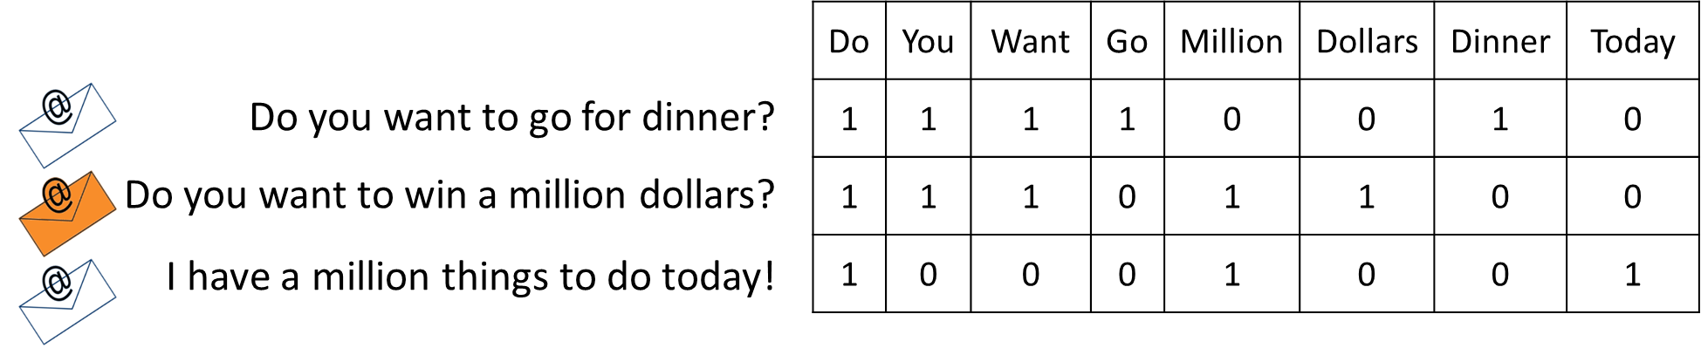
Derived Features
As we saw, the bag-of-words (also called BoW) is not always a very good feature (it confuses polysemous words). However, it is still extremely popular due to its simplicity
Bagged/binned features
Pooled/aggregated features
ESC101 (A), ESO207 (B), CS220 (B), CS340 (C), MSO201 (A), CS771 (A)
A B C D E F
ESC101 (A), ESO207 (B), CS220 (B), CS340 (C), MSO201 (A), CS771 (A)
10 (max), 8.67 (avg)
The way we represented emails in the spam problem is called the bag-of-words feature

Slide 20


Feature Selection??
Useful for predicting expenditure
DIET (VEG/NON-VEG)
Not useful for predicting expenditure
EYE COLOR
TOTAL INCOME
EDUCATION LEVEL
FAMILY SIZE
HOUSE NO (ODD/EVEN)
NO OF CHILDREN
In fact, one reason for the success of deep learning is that it learns good features themselves!
RENTED/SELF OWNED
(EXPENDITURE)
SURNAME LENGTH
Can we perform automatic feature selection?
Yes indeed, but those methods are a bit advanced for now!
True, but more on deep learning later! For now, back to basics.

Slide 21
A bit of caution with features
Tricks, mnemonics lessen cognitive load, increase speed
Easy questions can be solved in one step with a mnemonic!
Too many mnemonics can confuse you at time of exam
Derived features make learning easier, faster at test
What you are trying to predict is just another feature of the data!
Too many useless features can confuse classifier
However, not to worry. For most of this course, we will give you pre-made feature vectors ☺
In fact, one of the main challenges in deep learning is that it learns way too many features

Slide 22

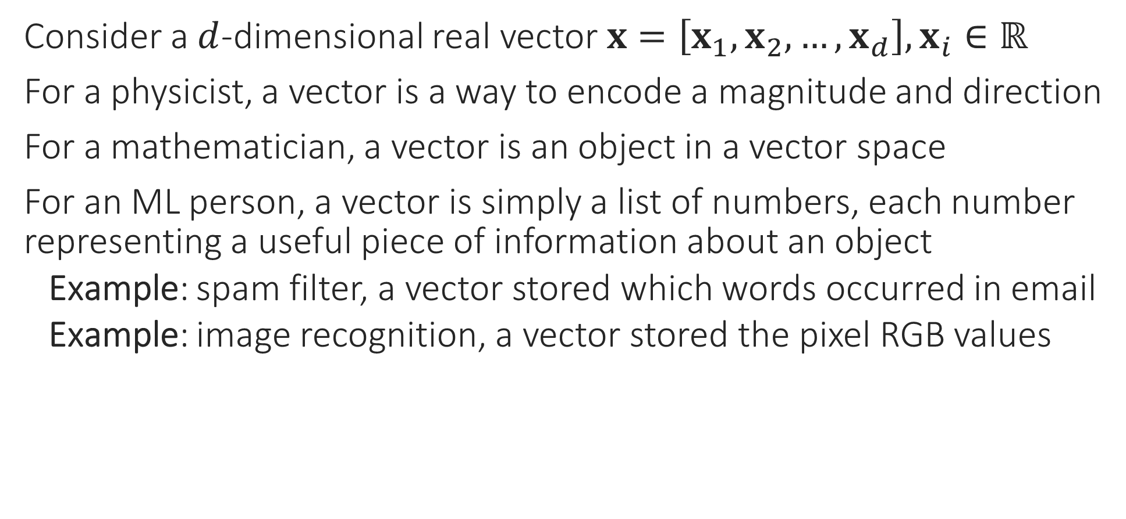
What are Vectors
Consider a $d$-dimensional real vector $x=\left[x_{1},x_{2},…,x_{d}\right],x_{i}∈ℝ$
For a physicist, a vector is a way to encode a magnitude and direction
For a mathematician, a vector is an object in a vector space
For an ML person, a vector is simply a list of numbers, each number representing a useful piece of information about an object
Example: spam filter, a vector stored which words occurred in email
Example: image recognition, a vector stored the pixel RGB values
Does this mean I will have to learn math to do ML?
A bit of math will be required but 1) it will be simple and 2) it will be totally worth it!
True, for me, vectors are just like arrays of numbers. However, sometimes I do indeed do math with them

Slide 23
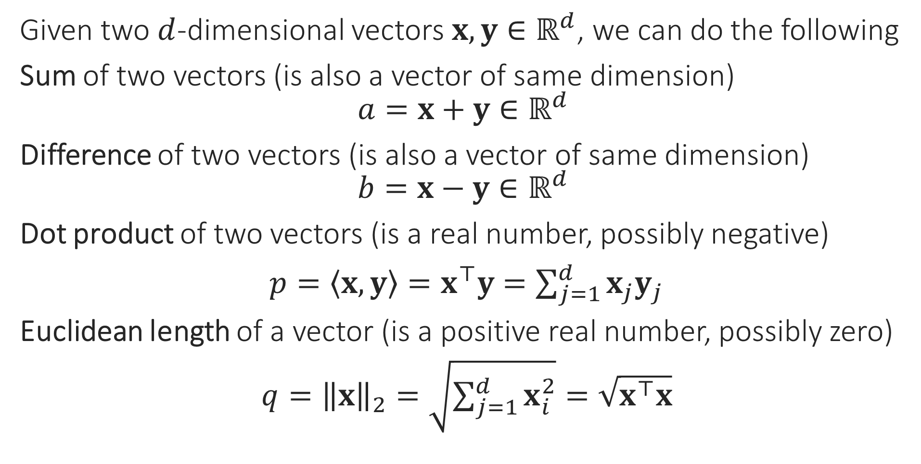
Operations on Vectors
Given two $d$-dimensional vectors $x,y∈ℝ^{d}$, we can do the following
Sum of two vectors (is also a vector of same dimension)
$$a=x+y∈ℝ^{d}$$
Difference of two vectors (is also a vector of same dimension)
$$b=x−y∈ℝ^{d}$$
Dot product of two vectors (is a real number, possibly negative)
$p=\left\langle x,y\right\rangle =x^{⊤}y=\sum_{j=1}^{d}{x_{j}y_{j}}$
Euclidean length of a vector (is a positive real number, possibly zero)
$q={\left\|x\right\|}_{2}=\sqrt{\sum_{j=1}^{d}{x_{i}^{2}}}=\sqrt{x^{⊤}x}$
Good point – just wait a second for some intuition. However, to be honest, sometimes it is good in ML not to hunt too much for intuition and just let the math be!
So I can take two feature vectors and add them. But what sense does it make to add two emails?

Slide 24



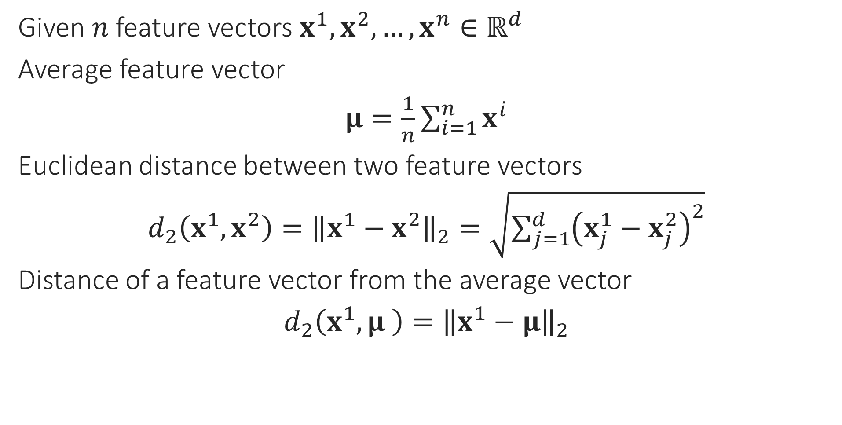
ML Operations on Feature Vectors
I can use this to find out what an “average” email looks like ☺. So averaging vectors makes sense!
Given $n$ feature vectors $x^{1},x^{2},…,x^{n}∈ℝ^{d}$
Average feature vector
$μ=\frac{1}{n}\sum_{i=1}^{n}{x^{i}}$
Euclidean distance between two feature vectors
$d_{2}\left(x^{1},x^{2}\right)={\left\|x^{1}−x^{2}\right\|}_{2}=\sqrt{{\sum_{j=1}^{d}{\left(x_{j}^{1}−x_{j}^{2}\right)}}^{2}}$
Distance of a feature vector from the average vector
$d_{2}\left(x^{1},μ \right)={\left\|x^{1}−μ\right\|}_{2}$
I can use this to find out if two emails are similar or very different from each other
I can use this to find out if a new email is similar to an average spam email or an average regular email
Excellent! We are now ready for our first ML algorithm!!

Slide 25
Learning with Prototypes
The basic mantra here is
If a new email looks similar to an average spam email, it maybe spam. On the other hand, if a new email looks similar to an average normal email, it should be normal
In ML, the word prototype is used to refer to something that is representative or captures the qualities of a class of objects?
How can we do ML using prototypes?
“
“

Slide 26

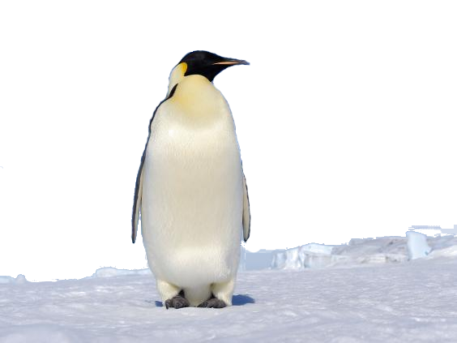
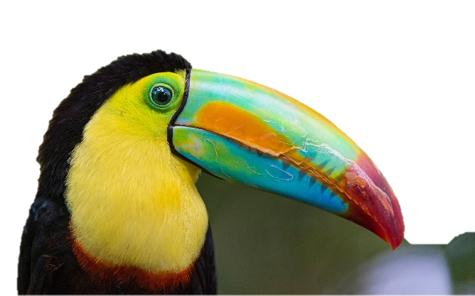
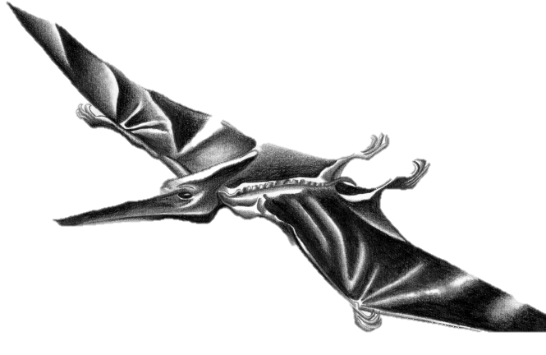
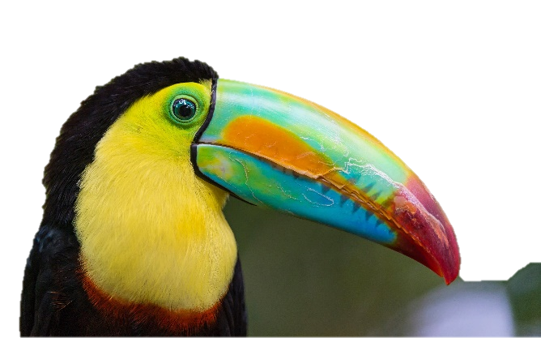



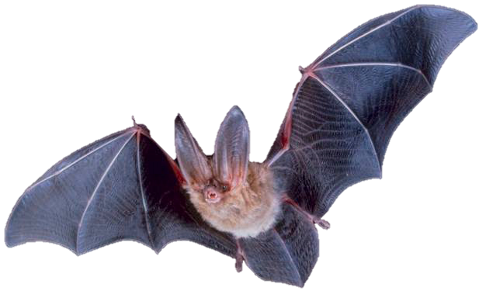

Bird or not!
But the Pterosaur will still get classified as a bird – it has wings and a beak
Important for deciding bird or not
Has wings
Can fly
Not that important for deciding bird or not
Can sing
This means that our prototype is not good enough and we may need better features
A prototypical bird!
Has a beak
What abstract qualities do we associate with “birdness”

Slide 27
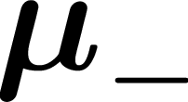
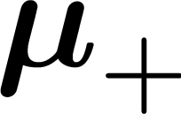




Learning with Prototypes
Feature vectors of normal emails
Prototype normal email
Feature vectors of spam emails
Wow! So so this is your model – just two vectors. You were able to distil all the information in the training emails into just two prototype vectors!!
Prototype spam email
In order to classify a new email as spam/non-spam I only need the two prototypes, not the training emails
In fact I can even handle cases where there are more than two classes e.g. instead of spam/non-spam, suppose the classes were Primary, Social, Updates …
This email is closer to the prototype spam email than the prototype normal email so I will classify this new email as spam!

Slide 28


Learning with Prototypes - Issues
If there is too much diversity in a class of objects, a single prototype may not be able to capture all the information
Yes, of course. But we will have to wait till we learn clustering before we can do so.
Normal work emails
Can we have two or more prototypes for the normal class?
Normal friend emails
What went wrong? The new email clearly resembled normal emails more than spam ones!

Slide 29

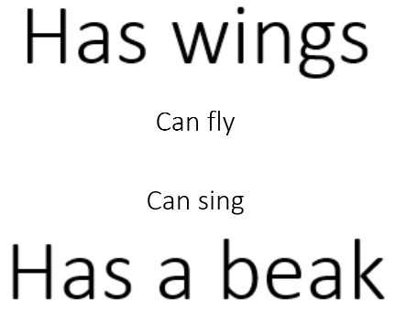
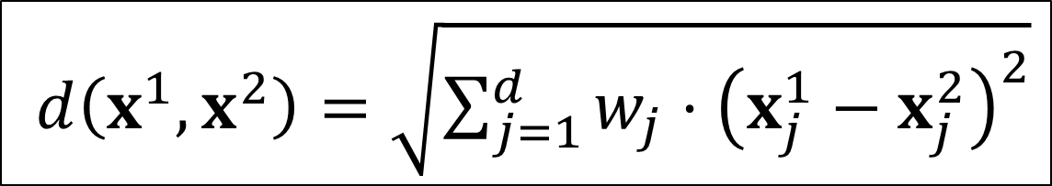
Learning with Prototypes - Issues
I think this time another issue is how we calculated distances. Can we use non-Euclidean distances?
What went wrong this time?
Can we learn these weights too?
Yes, but let us revisit this issue later
$d\left(x^{1},x^{2}\right)=\sqrt{{\sum_{j=1}^{d}{w_{j}⋅\left(x_{j}^{1}−x_{j}^{2}\right)}}^{2}}$
Well, notice that there is still a lot of intra-class diversity within the spam and the normal email classes
I think so too! E.g. we can give different weights to features while calculating distances

Slide 30
Learning with Prototypes - Lessons
An extremely simple technique to classify data
Can do binary classification (2-classes) as well as multi-classification
Very compact, light-weight model (one prototype per class)
Actually used in industrial applications like extreme classification
Actually state of the art if we have very few data points for a class
For example, if we have very few spam emails in training data
Works well when class data points are packed closely – less diversity
Improvements possible using multiple prototypes, metric learning (using a non-Euclidean distance function)

Slide 31
Nearest Neighbour Classifier
A really extreme form of learning with prototypes
Recall that we commented that having multiple (say 2-3) prototypes may help when there is lots of diversity in a class
With NN, every single training point becomes a prototype ☺
The basic mantra here seems to be
If the training email that most resembles a new email was spam, maybe the new email is spam too. Else, if a normal training email most resembles the new email, the new email should be normal
“
“

Slide 32
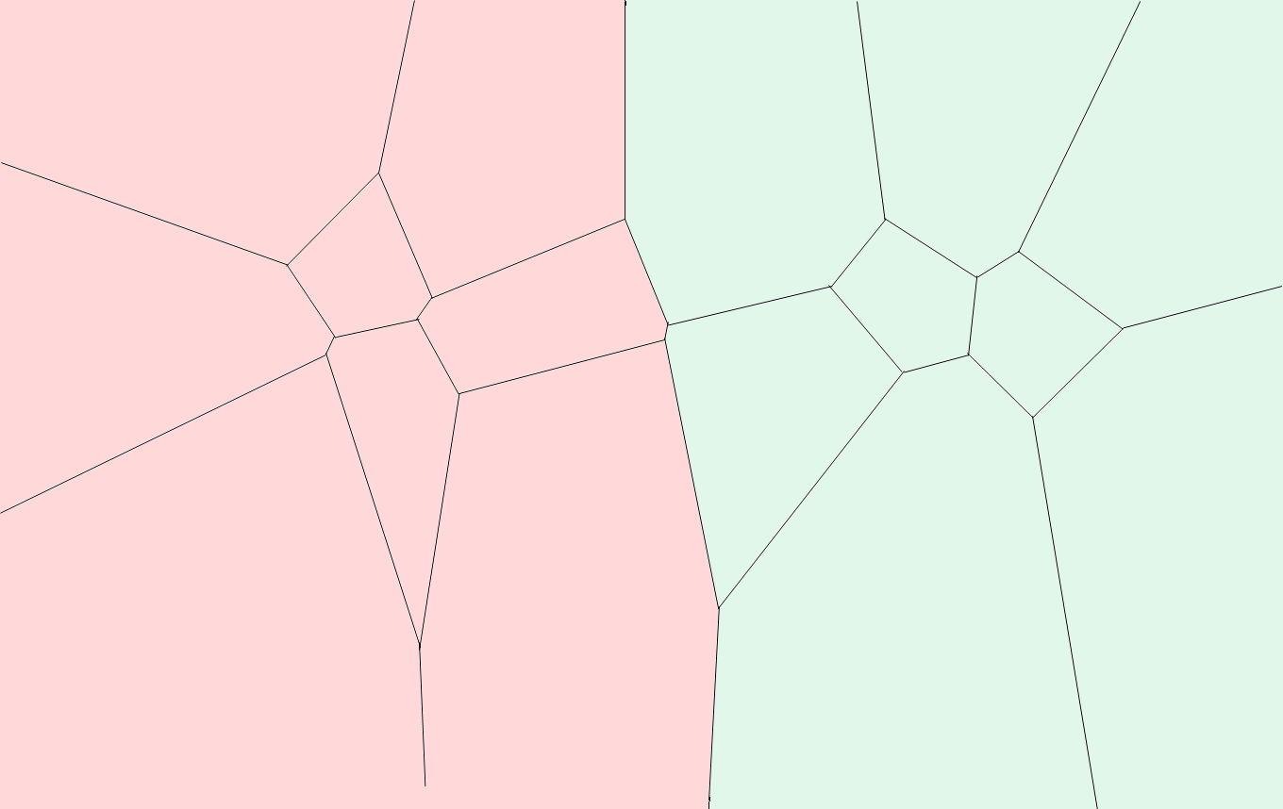
Learning with the 1-NN Classifier
1NN faces much of the same difficulties as learning with prototypes does. In the next class we will study these techniques more

